Slide 1
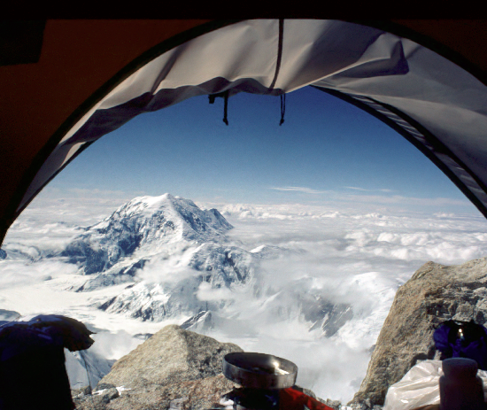
Chapter 7 System Design: Addressing Design Goals

Slide 2
Overview
System Design I
0. Overview of System Design
1. Design Goals
2. Subsystem Decomposition
Architectural Styles
System Design II
3. Concurrency
4. Hardware/Software Mapping
5. Persistent Data Management
6. Global Resource Handling and Access Control
7. Software Control
8. Boundary Conditions

Slide 3
Background
During system design, we identify;
design goals
decompose the system into subsystems
refine the subsystem decomposition until all design goals are addressed.
In the previous chapter
we described the concepts of design goals and system decomposition.
In this chapter,
We will introduce the system design activities that address the design goals.

Slide 4
Cont..
In particular, we examine
Selection of off-the-shelf and legacy components.
Mapping of subsystem to hardware
Design of a persistent data management infrastructure
Specification of an access control policy
Design of the global control flow
Handling of boundary conditions

Slide 5
System Design Activities
Mapping Subsystems to Processors and Components (Section 7.4.1)
Identifying and Storing Persistent Data (Section 7.4.2)
Providing Access Control (Section 7.4.3)
Designing the Global Control Flow (Section 7.4.4)
Identifying Services (Section 7.4.5)
Identifying Boundary Conditions (Section 7.4.6)
Reviewing the System Design Model (Section 7.4.7).

Slide 6
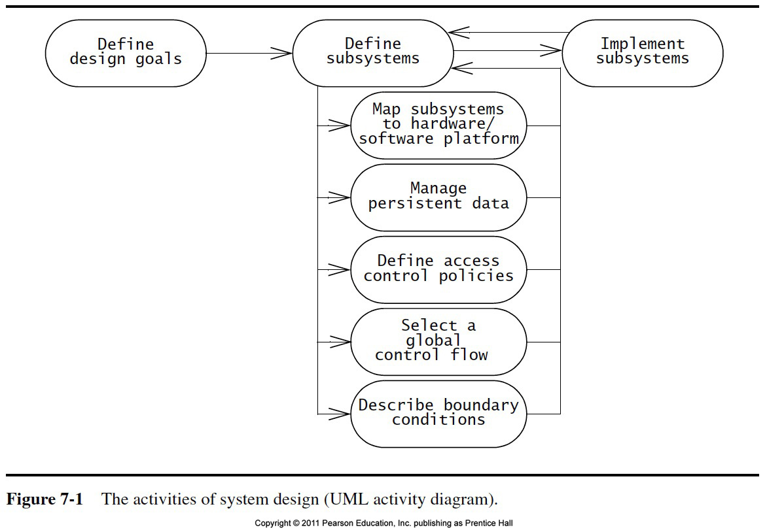

Slide 7
UML Deployment Diagrams
Deployment Diagram:
They are used to show the relationship among run-time components and nodes.
Illustrates the distribution of components at run-time.
Component Diagram:
Components are self-contained entities that provide services to other or actors
Illustrates dependencies between components at design time, compilation time and runtime

Slide 8
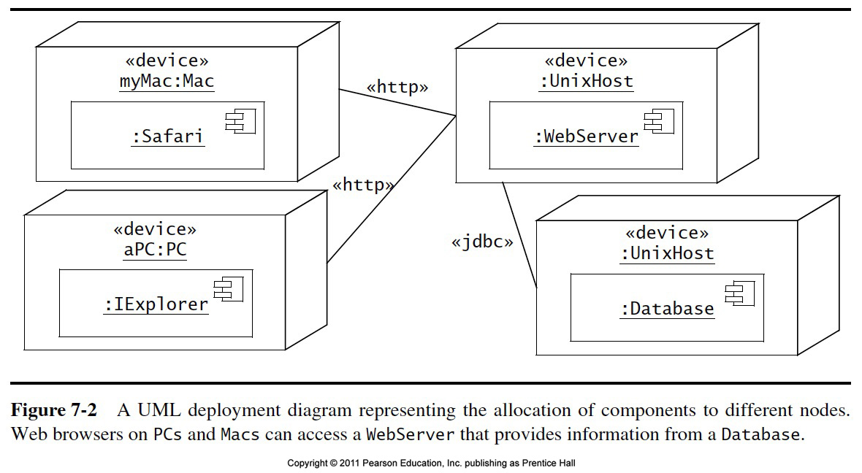

Slide 9
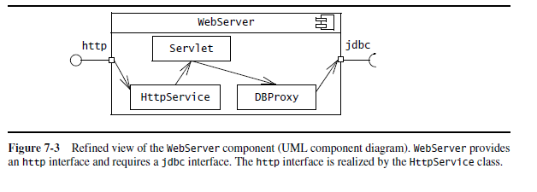
Cont..
The deployment diagram in Figure 7-2 focuses on the allocation of components to nodes and provides a high-level view of each component.
Components can be refined to include information about the interfaces they provide and the classes they contain

Slide 10
UML Interfaces: Lollipops and Sockets
A UML interface describes a group of operations used or created by UML components.
There are two types of interfaces: provided and required interfaces.
A provided interface is modeled using the lollipop notation
A required interface is modeled using the socket notation.
A port specifies a distinct interaction point between the component and its environment.
Ports are depicted as small squares on the sides of classifiers.

Slide 11
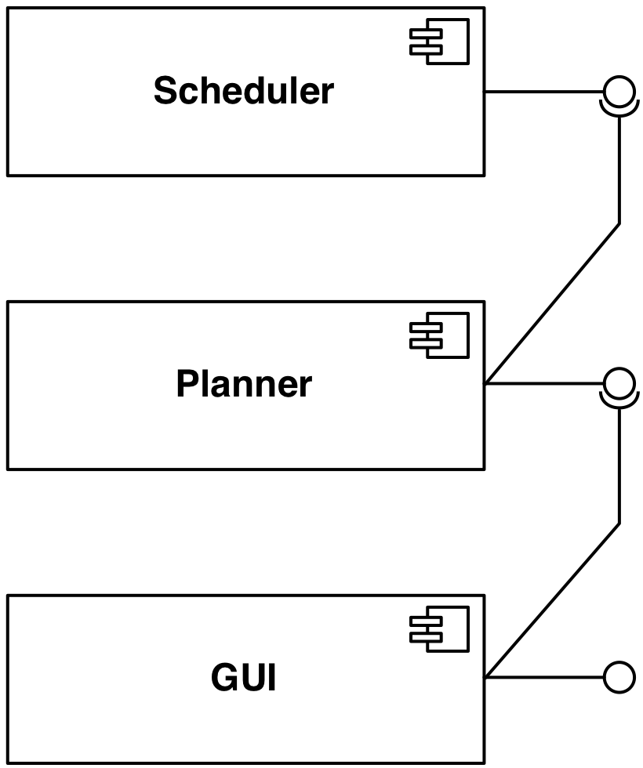
Component Diagram Example
Dependency.
reservations
UML
Component
update
UML Interface

Slide 12
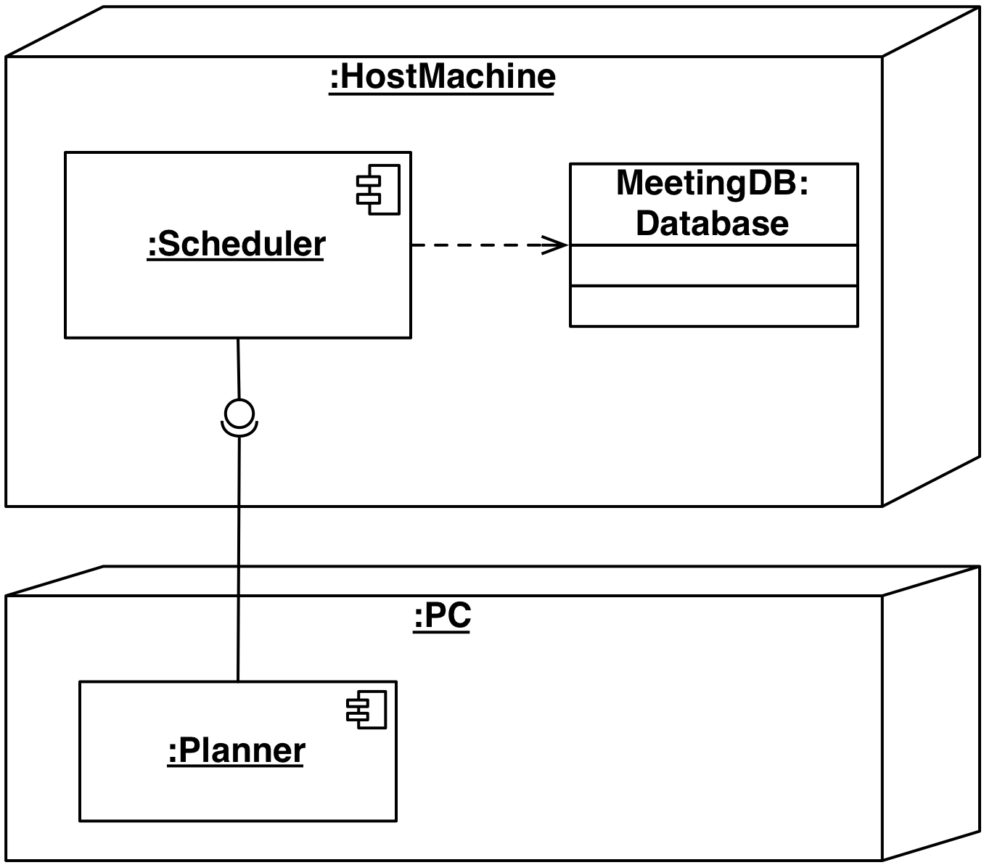
Deployment Diagram Example
UML Node
Dependency
(in a node)
UML
Interface
Dependency
(between nodes)

Slide 13
System Design
8. Boundary
Conditions
1. Design Goals
Definition
Trade-offs
Initialization
Termination
Failure
2. Subsystem Decomposition
7. Software
Control
Layers vs Partitions
Coherence/Coupling
Monolithic
Event-Driven
Conc. Processes
3. Concurrency
Identification of
Threads
4. Hardware/
Software Mapping
5. Data
Management
6. Global Resource
Handlung
Special Purpose
Buy vs Build
Allocation of Resources
Connectivity
Persistent Objects
File system vs Database
Access Control List
vs Capabilities
Security

Slide 14
Concurrency
Nonfunctional Requirements to be addressed: Performance, Response time, latency, availability.
Two objects are inherently concurrent if they can receive events at the same time without interacting
Inherently concurrent objects can be assigned to different threads of control
Objects with mutual exclusive activity could be folded into a single thread of control
Notes:
Objects with mutual exclusive activity could be folded into a single thread of control (Why?)
Should client and server of a client/server architecture be folded on the same thread?
If there are multiple clients?
If there is only a single client and the server?.

Slide 15
Thread of Control
A thread of control is a path through a set of state diagrams on which a single object is active at a time
A thread remains within a state diagram until an object sends an event to different object and waits for another event
Thread splitting: Object does a non-blocking send of an event to another object.
Concurrent threads can lead to race conditions.
A race condition (also race hazard) is a design flaw where the output of a process is depends on the specific sequence of other events.
The name originated in digital circuit design: Two signals racing each other to influence the output.
Notes:
Example: An instance of a client/server architectural style consists of at least two threads
A race condition or race hazard is a flaw in a system or process whereby the output and/or result of the process is unexpectedly and critically dependent on the sequence or timing of other events. The term originates with the idea of two signals racing each other to influence the output first.

Slide 16
Example: Problem with threads
Assume: Initial balance = 200
:WithdrawCtrl
:BankAccount
:WithdrawCtrl
c1:Customer
c2:Customer
withdraw(50)
getBalance()
Thread 1
200
withdraw(50)
getBalance()
computeNewBalance(200,50)
Thread 2
200
computeNewBalance(200,50)
setBalance(150)
setBalance(150)
Should BankAccount
be another Thread ?
Final
balance = 150 ??!
Notes:
When you introduce the second customer, say that he interacts with his own control object of type WithdrawCtrl
Ask this question at the end of the animation: Can thread 1 or 2 be folded with thread 3?

Slide 17
Solution: Synchronization of Threads
Initial balance = 200
Single WithdrawCtrl Instance
:WithdrawCtrl
:BankAccount
Synchronized method
c1:Customer
c2:Customer
withdraw(50)
getBalance()
withdraw(50)
200
computeNewBalance(200,50)
setBalance(150)
End balance = 100

Slide 18
Concurrency Questions
To identify threads for concurrency we ask the following questions:
Does the system provide access to multiple users?
Which entity objects of the object model can be executed independently from each other?
What kinds of control objects are identifiable?
Can a single request to the system be decomposed into multiple requests? Can these requests and handled in parallel? (Example: a distributed query)
Notes:
Examples for requests:
Examples:
Sorting request
Searching request in a distributed data base
Image recognition by decomposing the image into stripes
Matrix multiplication with a systolic array algorithm

Slide 19
Implementing Concurrency
Concurrent systems can be implemented on any system that provides
Physical concurrency: Threads are provided by hardware
or
Logical concurrency: Threads are provided by software
Physical concurrency is provided by multiprocessors and computer networks
Logical concurrency is provided by threads packages.
Notes:
Logical concurrency is provided by threads packages : Java, for example, has a thread abstraction

Slide 20
Implementing Concurrency (2)
In both cases, - physical concurrency as well as logical concurrency - we have to solve the scheduling of these threads:
Which thread runs when?
Today’s operating systems provide a variety of scheduling mechanisms:
Round robin, time slicing, collaborating processes, interrupt handling
General question addresses starvation, deadlocks, fairness -> Topic for researchers in operating systems
Sometimes we have to solve the scheduling problem ourselves
Topic addressed by software control (system design topic 7).
Notes:
Round robin, time slicing, collaborating processes, interrupt handling
Topics in operating systems!!!

Slide 21
System Design
8. Boundary
Conditions
1. Design Goals
Definition
Trade-offs
Initialization
Termination
Failure
2. Subsystem Decomposition
7. Software
Control
Layers vs Partitions
Coherence/Coupling
Monolithic
Event-Driven
Conc. Processes
3. Concurrency
Identification of
Threads
4. Hardware/
Software Mapping
5. Data
Management
6. Global Resource
Handlung
Special Purpose
Buy vs Build
Allocation of Resources
Connectivity
Persistent Objects
Filesystem vs Database
Access Control List
vs Capabilities
Security

Slide 22
Selecting a hardware configuration and a platform
Many systems run on more than one computer and depend on access to internet
The use of multiple computers can address high-performance needs and interconnect multiple distributed uses
We need to examine:
The allocation of subsystems to computers
The design of the infrastructure for supporting communication between subsystems

Slide 23
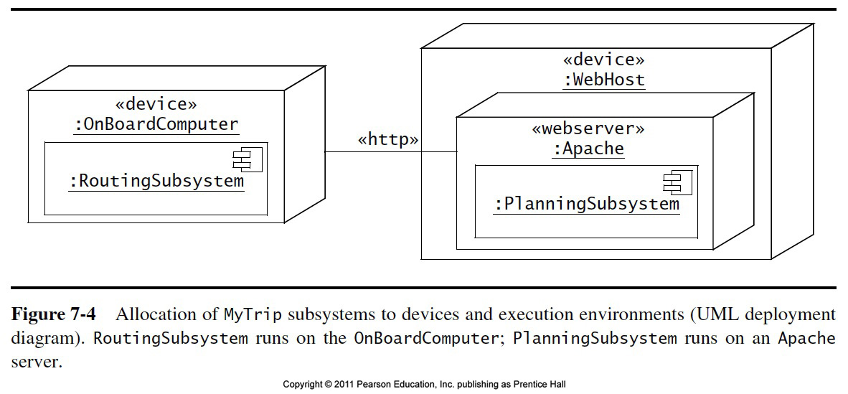

Slide 24
4. Hardware Software Mapping
This system design activity addresses two questions:
How shall we realize the subsystems: With hardware or with software?
How do we map the object model onto the chosen hardware and/or software?
Mapping the Objects:
Processor, Memory, Input/Output
Mapping the Associations:
Network connections
Notes:
A first heuristic would be Control objects need a processor, Entity objects need memory
Boundary objects should be mapped to input/output devices.
These abstractions are available in hardware as well as in software.

Slide 25
Mapping Objects onto Hardware
Control Objects -> Processor
Is the computation rate too demanding for a single processor?
Can we get a speedup by distributing objects across several processors?
How many processors are required to maintain a steady state load?
Entity Objects -> Memory
Is there enough memory to buffer bursts of requests?
Boundary Objects -> Input / Output Devices
Do we need an extra piece of hardware to handle the data generation rates?
Can the desired response time be realized with the available communication bandwidth between subsystems?
Notes:
Does the response time exceed the available bandwith for a task and a piece of hardware?

Slide 26
Mapping the Associations: Connectivity
Describe the physical connectivity
Describes which associations in the object model are mapped to physical connections.
Describe the logical connectivity (subsystem associations)
Associations that do not directly map into physical connections.
In which layer should these associations be implemented?
Informal connectivity drawings often contain both types of connectivity
Practiced by many developers, sometimes confusing.
Notes:
Describe the physical connectivity of the hardware
This is usually the physical layer in the OSI Reference Model
Which associations in the object model are mapped to physical connections?
Which of the client-supplier relationships in the analysis/design model correspond to physical connections?
Describe the logical connectivity (subsystem associations)
Identify associations that do not directly map into physical connections:
How should these associations be implemented?

Slide 27
Example: Informal Connectivity Drawing
TCP/IP
Logical
Connectivity
Ethernet Cat 5
Physical
Connectivity

Slide 28
Logical vs Physical Connectivity and the relationship to Subsystem Layering
Application Layer
Application Layer
Presentation Layer
Presentation Layer
Logical
Connectivity
Session Layer
Session Layer
Bidirectional associa- tions for each layer
Transport Layer
Transport Layer
Network Layer
Network Layer
Data Link Layer
Data Link Layer
Physical
Connectivity
Physical Layer
Physical Layer
Processor 1
Processor 2

Slide 29
Allocating objects and subsystems to nodes
Once the hardware configuration has been defined and the virtual machines selected, objects and subsystems are assigned to nodes.
This often triggers the identification of new objects and subsystems for transporting data among the nodes.
Example:
In the MyTrip system, both RoutingSubsystem and PlanningSubsystem share the objects
Trip, Destination, Crossing, Segment, and Direction.
Instances of these classes need to communicate via a wireless modem using some communication protocol.

Slide 30
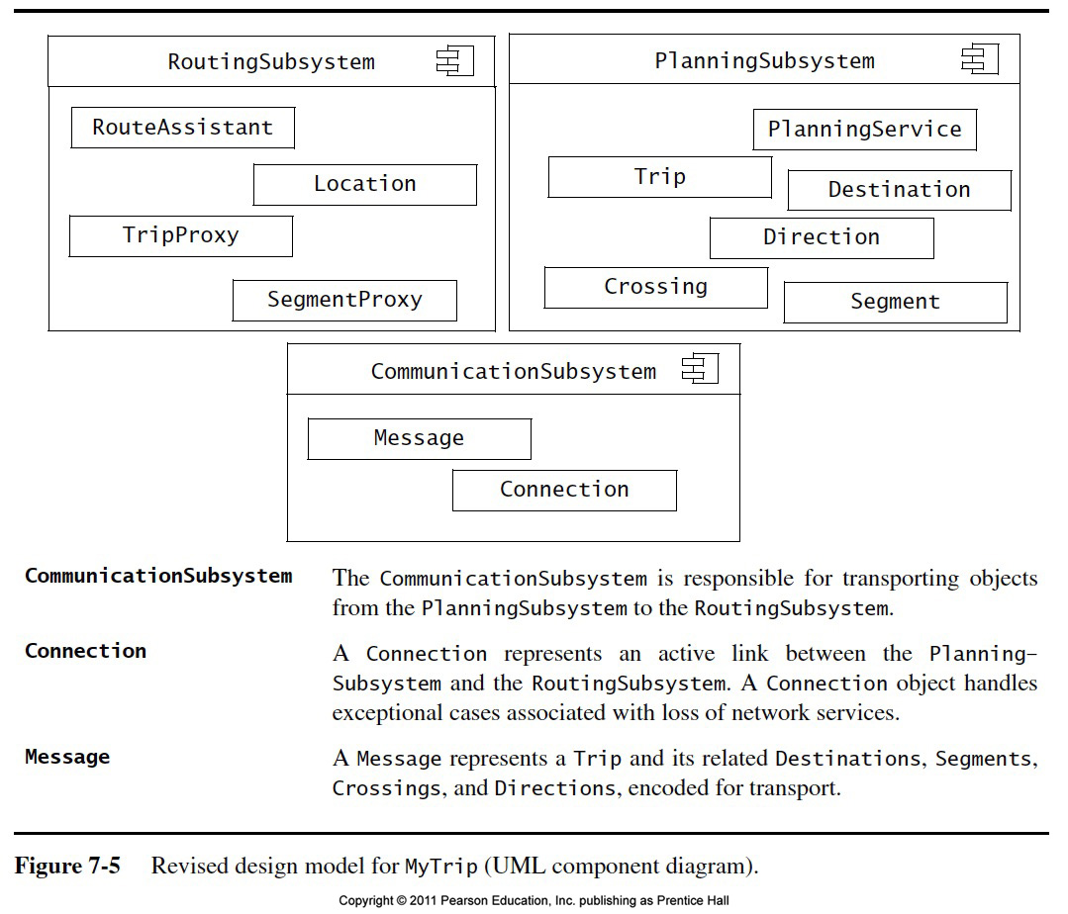

Slide 31
5. Data Management
Some objects in the system model need to be persistent:
Values for their attributes have a lifetime longer than a single execution
A persistent object can be realized with one of the following mechanisms:
Filesystem:
If the data are used by multiple readers but a single writer
Database:
If the data are used by concurrent writers and readers.
Notes:
Some objects in the system model need to be persistent
Provide clean separation points between subsystems with well-defined interfaces.
Data structure
If the data can be volatile
Files
If the data has a lifetime longer than a single execution
Cheap, simple, permanent storage
Low level (Read, Write)
Applications must add code to provide suitable level of abstraction
Database
Powerful, easy to port
Supports multiple writers and readers

Slide 32
Data Management Questions
How often is the database accessed?
What is the expected request (query) rate? The worst case?
What is the size of typical and worst case requests?
Do the data need to be archived?
Should the data be distributed?
Does the system design try to hide the location of the databases (location transparency)?
Is there a need for a single interface to access the data?
What is the query format?
Should the data format be extensible?
Notes:
Should the database be relational or object-oriented?

Slide 33
Trade-off between flat files, relational databases, and object-oriented databases
When should you choose flat files?
Voluminous data (e.g., images)
Temporary data (e.g., core file)
Low information density (e.g., archival files, history logs)
When should you choose a relational or an object-oriented database?
Concurrent accesses
Access at finer levels of detail
Multiple platforms or applications for the same data

Slide 34
Cont..
When should you choose a relational database?
Complex queries over attributes
Large data set
When should you choose an object-oriented database?
Extensive use of associations to retrieve data
Medium-sized data set
Irregular associations among objects

Slide 35
Mapping Object Models
UML object models can be mapped to relational databases
The mapping:
Each class is mapped to its own table
Each class attribute is mapped to a column in the table
An instance of a class represents a row in the table
One-to-many associations are implemented with a buried foreign key
Many-to-many associations are mapped to their own tables
Methods are not mapped
Notes:
UML object models can be mapped to relational databases
Some degradation occurs because all UML constructs must be mapped to a single relational database construct - the table
UML mappings (Chapter 10, p 414ff)

Slide 36
Global Resource Handling
Discusses access control
Describes access rights for different classes of actors
Describes how object guard against unauthorized access.

Slide 37
Defining Access Control
In multi-user systems different actors usually have different access rights to different functionality and data
How do we model these accesses?
During analysis we model them by associating different use cases with different actors
During system design we model them determining which objects are shared among actors.
Notes:
During system design we model them by examining the object model by determining which objects are shared among actors.
Depending on the security requirements of the system, we also define how actors are authenticated
to the system and how selected data in the system should be encrypted.

Slide 38
Access Matrix
We model access on classes with an access matrix:
The rows of the matrix represents the actors of the system
The column represent classes whose access we want to control
Access Right: An entry in the access matrix. It lists the operations that can be executed on instances of the class by the actor.

Slide 39
Access Matrix Example
Classes
Access Rights
Actors
Arena
League
Tournament
Match
Operator
<<create>> createUser() view ()
<<create>> archive()
LeagueOwner
view ()
edit ()
<<create>> archive() schedule() view()
<<create>> end()
Player
view() applyForOwner()
view() subscribe()
applyFor() view()
play() forfeit()
Spectator
view() applyForPlayer()
view() subscribe()
view()
view() replay()

Slide 40
Access Matrix Implementations
Global access table: Represents explicitly every cell in the matrix as a triple (actor,class, operation)
LeagueOwner, Arena, view()
LeagueOwner, League, edit()
LeagueOwner, Tournament, <<create>>
LeagueOwner, Tournament, view()
LeagueOwner, Tournament, schedule()
LeagueOwner, Tournament, archive()
LeagueOwner, Match, <<create>>
LeagueOwner, Match, end()
.
Notes:
Global access table: Represents explicitly every cell in the matrix as a triple (actor,class, operation)
Determining if an actor has access to a specific object requires looking up the corresponding tuple. If no such tuple is found, access is denied.

Slide 41
Better Access Matrix Implementations
Access control list
Associates a list of (actor,operation) pairs with each class to be accessed.
Every time an instance of this class is accessed, the access list is checked for the corresponding actor and operation.
Capability
Associates a (class, operation) pair with an actor.
A capability provides an actor to gain control access to an object of the class described in the capability.
Notes:
Access control list associates a list of (actor,operation) pairs with each class to be accessed.
Every time an object is accessed, its access list is checked for the corresponding actor and operation.
Example: guest list for a party.
A capability associates a (class,operation) pair with an actor.
A capability provides an actor to gain control access to an object of the class described in the capability.
Example: An invitation card for a party.
Which is the right implementation?

Slide 42
Access Matrix Example
Arena
League
Tournament
Match
Match
Operator
<<create>> createUser() view ()
<<create>> archive()
LeagueOwner
view ()
edit ()
<<create>> archive() schedule() view()
<<create>> end()
Player
Player
view() applyForOwner()
view() subscribe()
applyFor() view()
play() forfeit()
play() forfeit()
Spectator
view() applyForPlayer()
view() subscribe()
view()
view() replay()

Slide 43
Match
Player
play() forfeit()

Slide 44
Access Control List Realization
Access Control List for m1
I am joe, I want to play in match m1
m1:Match
joe may play alice may play
joe:Player
Gatekeeper checks identification against list and allows access.

Slide 45
Capability Realization
Here’s my ticket, I’d like to play in match m1
m1:Match
joe:Player
Gatekeeper checks if ticket is valid and allows access.
Ticket for match “m1”
Capability

Slide 46
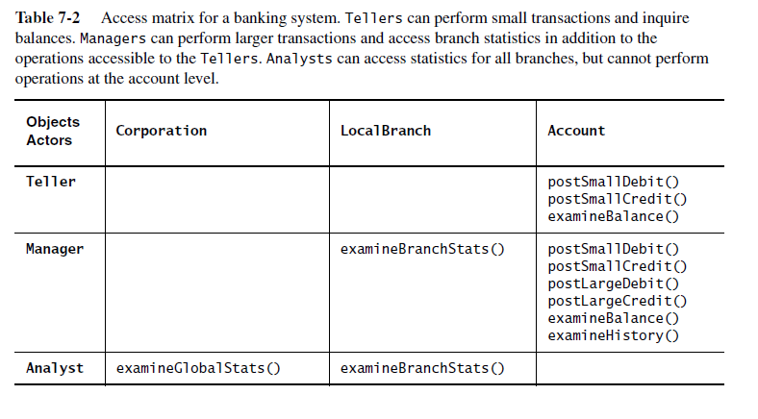
More Example

Slide 47
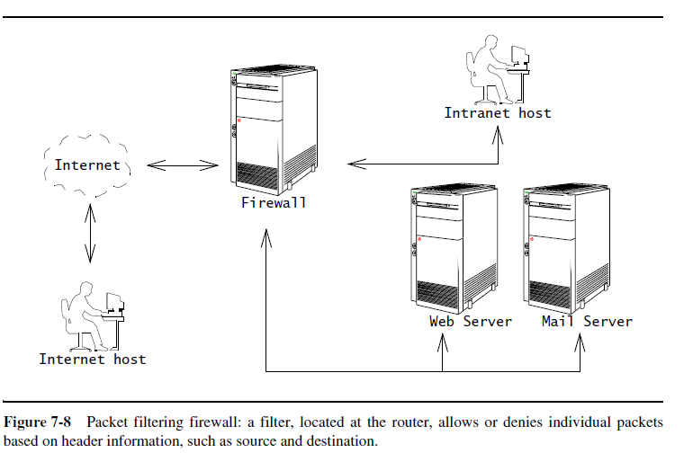
Cont..

Slide 48
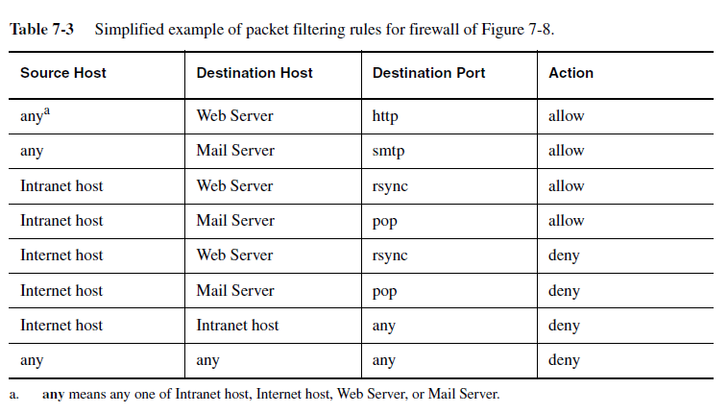

Slide 49
Global Resource Questions
Does the system need authentication?
If yes, what is the authentication scheme?
User name and password? Access control list
Tickets? Capability-based
What is the user interface for authentication?
Does the system need a network-wide name server?
How is a service known to the rest of the system?
At runtime? At compile time?
By Port?
By Name?

Slide 50
7. Decide on Software Control
Two major design choices:
1. Choose implicit control
2. Choose explicit control
Centralized or decentralized
Centralized control:
Procedure-driven: Control resides within program code.
Event-driven: Control resides within a dispatcher calling functions via callbacks.
Decentralized control
Control resides in several independent objects.
Examples: Message based system, RMI
Possible speedup by mapping the objects on different processors, increased communication overhead.
Notes:
Two major design choices:
1. Choose implicit control (non-procedural, declarative languages)
Rule-based systems
Logic programming
2. Choose explicit control (procedural languages): Centralized or decentralized
In the case of centralized control we have another choice: Procedure-driven or event-driven?
Procedure-driven control
Control resides within program code. Example: Main program calling procedures of subsystems.
Simple, easy to build, hard to maintain (high recompilation costs)
Event-driven control
Control resides within a dispatcher calling functions via callbacks.
Very flexible, good for the design of graphical user interfaces, easy to extend

Slide 51
Software Control
Explicit Control
Implicit Control
Rule-based Control
Logic Programming
Decentralized Control
Centralized Control
Event-based Control
Procedural Control.

Slide 52
Centralized vs. Decentralized Designs
Centralized Design
One control object or subsystem ("spider") controls everything
Change in the control structure is very easy
The single control object is a possible performance bottleneck
Decentralized Design
Not a single object is in control, control is distributed; That means, there is more than one control object
The responsibility is spread out
Fits nicely into object-oriented development

Slide 53
8. Boundary Conditions
Initialization
The system is brought from a non-initialized state to steady-state
Termination
Resources are cleaned up and other systems are notified upon termination
Failure
Possible failures: Bugs, errors, external problems
Good system design foresees fatal failures and provides mechanisms to deal with them.
Notes:
Most of the system design effort is concerned with the steady-state behavior described
in the analysis phase.
However, the system design phase must also address
the initiation and finalization of the system.
This is done with a set of new uses cases called administration use cases
Initialization
Describes how the system is brought from an non initialized state to steady-state ("startup use cases”)
Termination
Describes what resources are cleaned up and which systems are notified upon termination ("termination use cases")
Failure
Describes possible failures: Bugs, errors, external problems (power supply).
Good system design foresees fatal failures (“failure use cases”)

Slide 54
Boundary Condition Questions
Initialization
What data need to be accessed at startup time?
What services have to registered?
What does the user interface do at start up time?
Termination
Are single subsystems allowed to terminate?
Are subsystems notified if a single subsystem terminates?
How are updates communicated to the database?
Failure
How does the system behave when a node or communication link fails?
How does the system recover from failure?.
Notes:
8.1 Initialization
How does the system start up?
What data need to be accessed at startup time?
What services have to registered?
What does the user interface do at start up time?
How does it present itself to the user?
8.2 Termination
Are single subsystems allowed to terminate?
Are other subsystems notified if a single subsystem terminates?
How are local updates communicated to the database?
8.3 Failure
How does the system behave when a node or communication link fails? Are there backup communication links?
How does the system recover from failure? Is this different from initialization?

Slide 55
Summary
System design activities:
Concurrency identification
Hardware/Software mapping
Persistent data management
Global resource handling
Software control selection
Boundary conditions
Each of these activities may affect the subsystem decomposition
Two new UML Notations
UML Component Diagram: Showing compile time and runtime dependencies between subsystems
UML Deployment Diagram: Drawing the runtime configuration of the system.
Notes:
In this lecture, we reviewed the activities of system design:
….
Each of these activities may affects the subsystem decomposition to address a specific issue
Once these activities are completed, the interface of the subsystems can be defined.
This leads us to Object Design

